Slide 1
Parallel-O-Code

Slide 2
Index
Problem statement
Introduction
Literature
Design methodology
Technology Stack
References
Target Audience
Limitations
Quest. And Answer

Slide 3
Problem Statement
Parallel-O-Code
To provide the user with different set of standard algorithms written in accordance with parallelization in the field of coding algorithms and Image processing.

Slide 4
What is Parallel Programming?
In the simplest sense, parallel computing is the simultaneous use of multiple compute resources to solve a computational problem.
To be run using multiple CPUs
A problem is broken into discrete parts that can be solved concurrently
Each part is further broken down to a series of instructions
Instructions from each part execute simultaneously on different CPUs

Slide 5
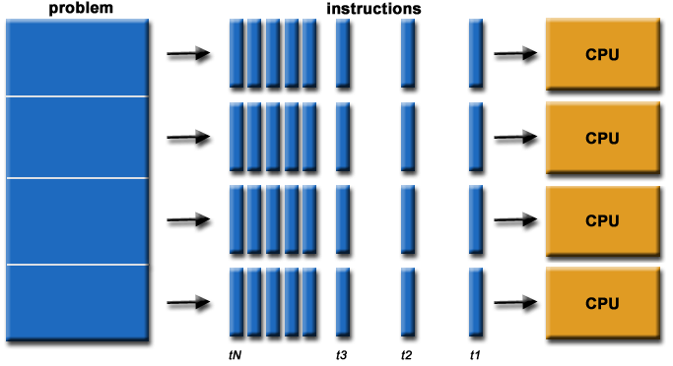
Parallel Programming continued….

Slide 6
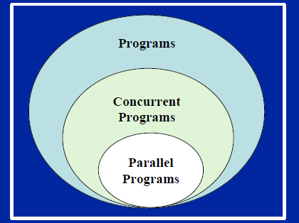
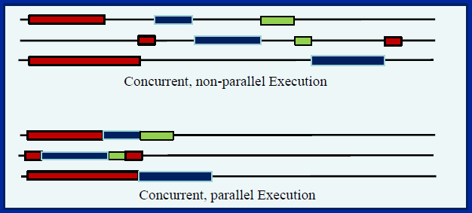
Parallel Programming continued...
Concurrency: A condition of a system in which multiple
Tasks are logically active at one time.
Parallelism: A condition of a system in which multiple
Tasks are actually active at one time.

Slide 7
Why do Parallel Programming?
Limits of single CPU computing
– performance
– available memory
Parallel computing allows one to:
– solve problems that don’t fit on a single CPU
– solve problems that can’t be solved in a reasonable time
We can solve…
– larger problems
– faster

Slide 8
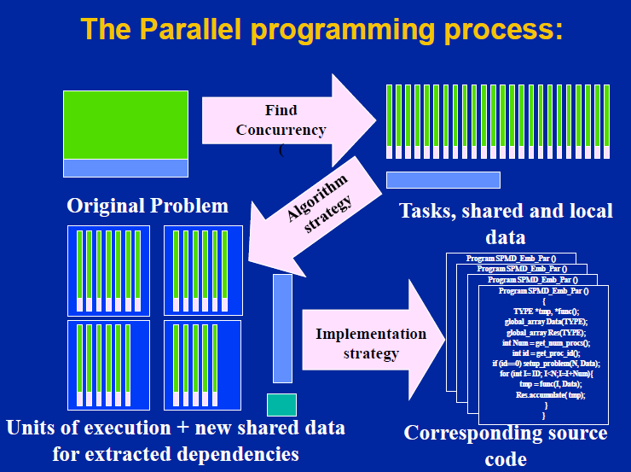
Parallel Programming continued...

Slide 9
Objectives To Acheive
Study of OpenMP to achieve best use of hardware with parallel programming in CPP.
Implementing the codes for widely used algorithms in regular way of serial programming and then same algorithms in parallel programming.
A study of image processing algorithms. Writing IP algorithms into CPP and converting serial code to efficient parallel code. Compare time taken in regular serial operations and parallel operations.
Design an web app based user interface to display achieved efficiency in time through parallel programming

Slide 10
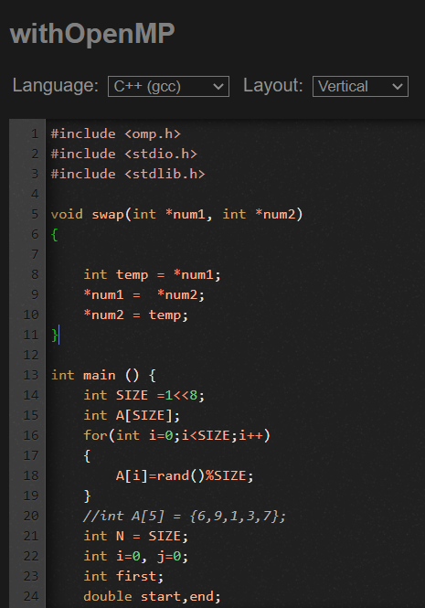
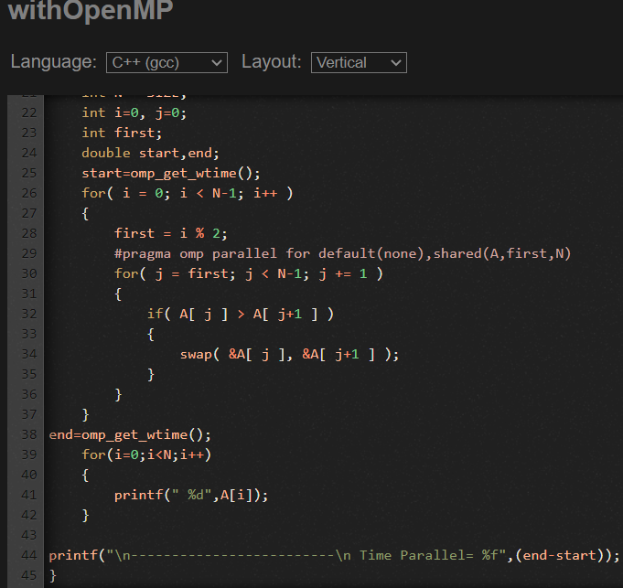
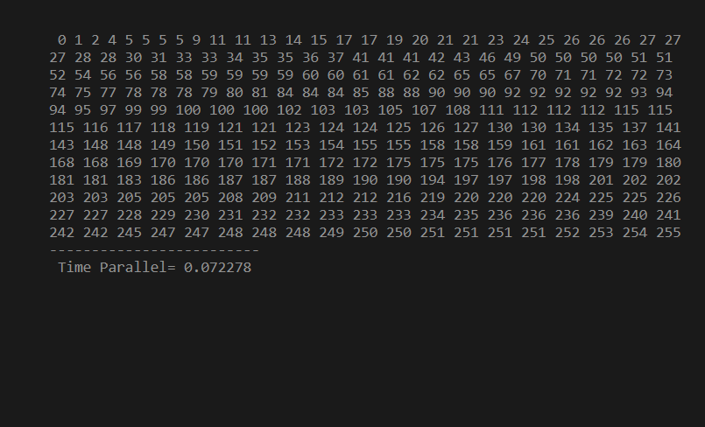
Parallel programming in Std. Algorithm Sector
1.Bubble Sort with OpenMP Output

Slide 11
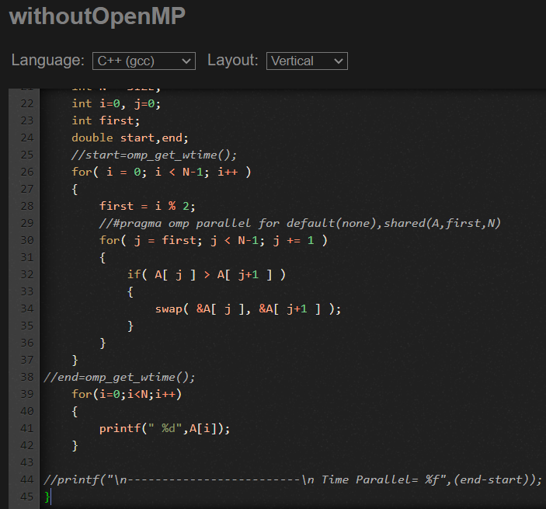
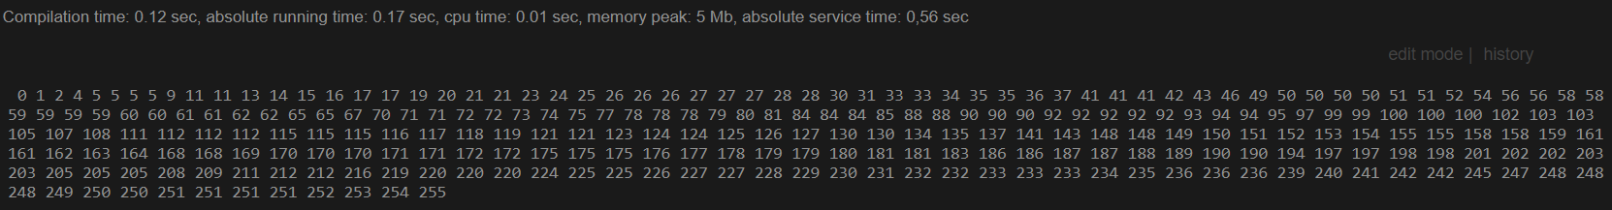
Parallel programming in Std. Algorithm Sector
1.Bubble Sort without OpenMP Output
The Time taken for execution is 0.17 sec which is greater than that of 0.072 sec executed with openMP

Slide 12
Parallel programming in Std. Algorithm Sector
1.Conclusion on bubble sort algo using OpenMP
#pragma omp parallel is OpenMP component that is applied When a parallel region is encountered, a logical team of threads is formed. Each thread in the team executes all statements within a parallel region except for work-sharing constructs.
The default(none) clause forces a programmer to explicitly specify the data-sharing attributes of all variables in a parallel region. ... Using this clause then forces the programmer to think about data-sharing attributes.
The shared(A,first,N) clause declares that all variables in the array A are shared along with first and N
If the pragma is used in outer loop it turns less efficient but if we use that in inner loop resources are shared properly and turns out to be more effecient

Slide 13
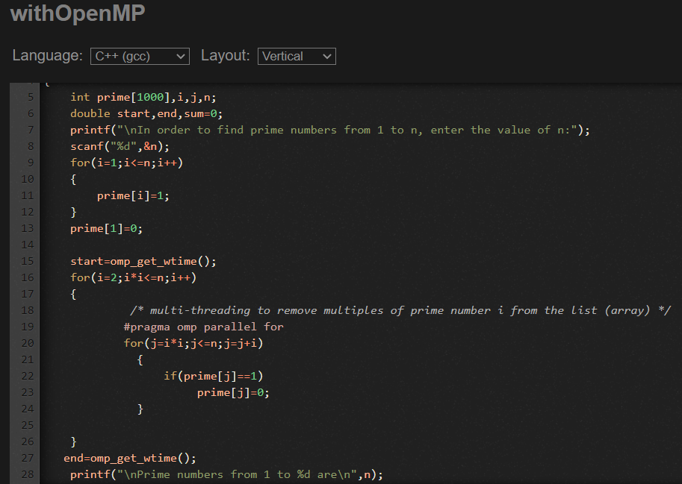
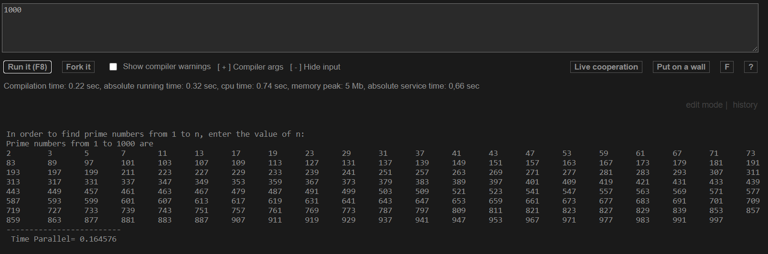
Parallel programming in Std. Algorithm Sector
2.Prime number(1-n) with OpenMP Output

Slide 14
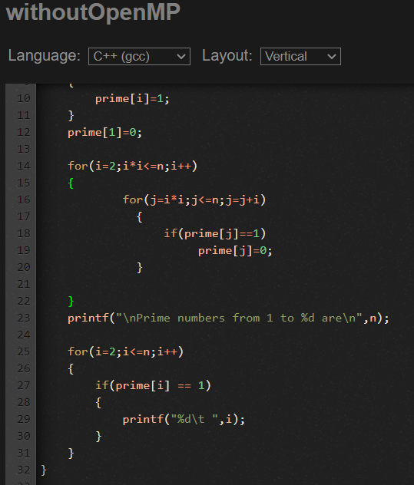
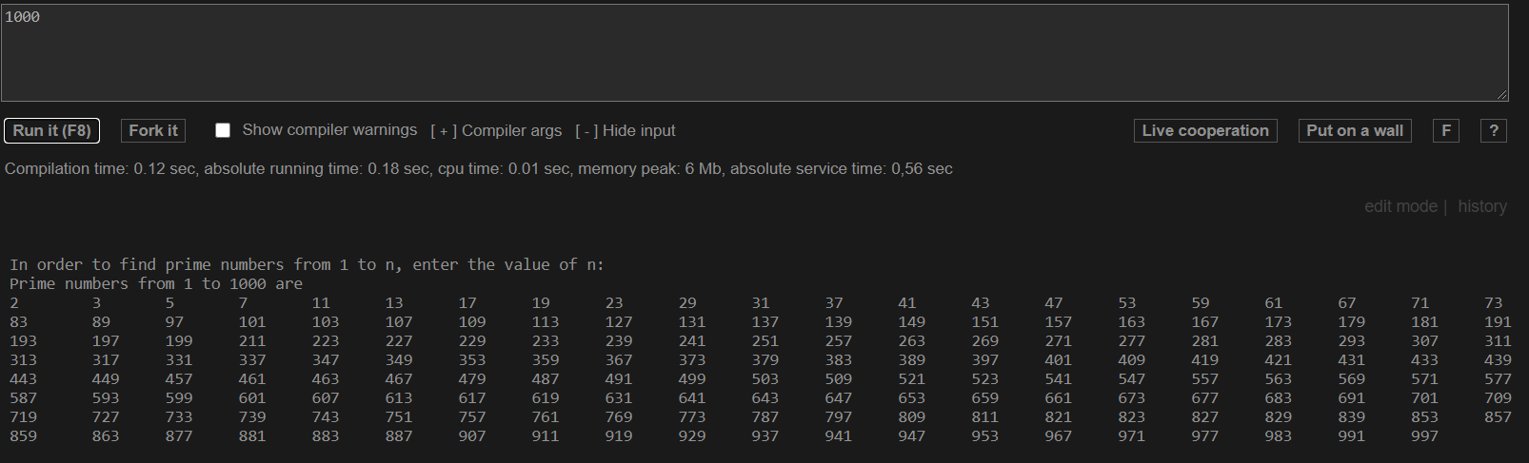
Parallel programming in Std. Algorithm Sector
2.Prime number(1-n) without OpenMP Output
The Time taken for execution is 0.18 sec which is greater than that of 0.16 sec executed with openMP

Slide 15
Parallel programming in Std. Algorithm Sector
2.Conclusion on Prime number algo using OpenMP
#pragma omp parallel is OpenMP component that is applied When a parallel region is encountered, a logical team of threads is formed. Each thread in the team executes all statements within a parallel region except for work-sharing constructs.
The omp_get_time() is used to get time at any respective moment within the code and then the threads that are executing the loop,its working time can be calculated
If the pragma is used in outer loop it turns less efficient but if we use that in inner loop resources are shared properly and turns out to be more efficient
The time achieved in parallel is very minimal in comparison with the serial code..because of less scope of distributing work in resources or threads.

Slide 16
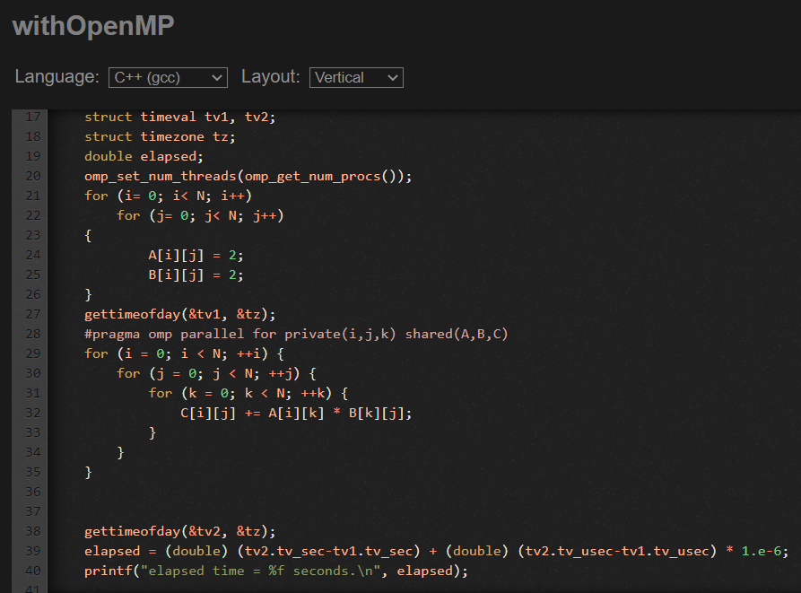
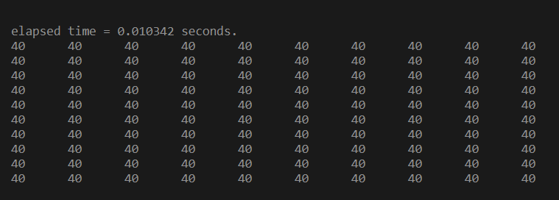
Parallel programming in Std. Algorithm Sector
3.Matrix Multiplication with OpenMP Output

Slide 17
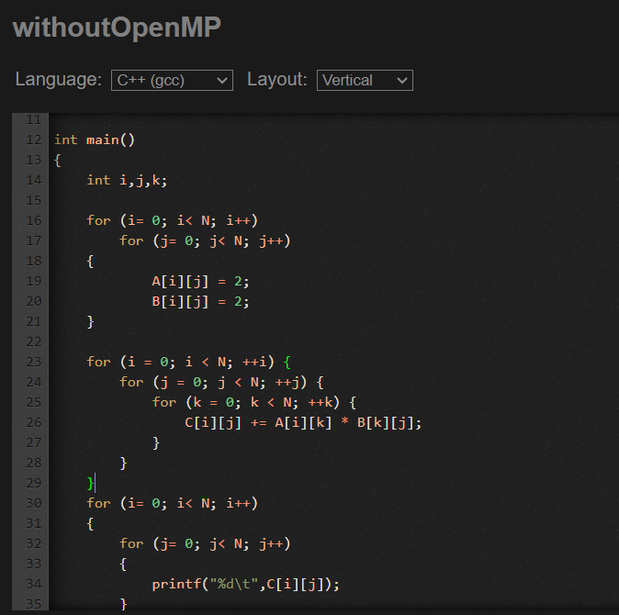
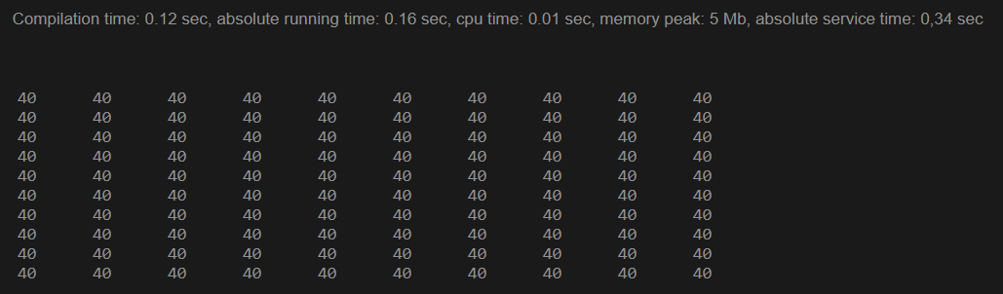
Parallel programming in Std. Algorithm Sector
3.Matrix Multiplication without OpenMP Output
The Time taken for execution is 0.16 sec which is greater than that of 0.01 sec executed with openMP

Slide 18
Parallel programming in Std. Algorithm Sector
3.Conclusion on Matrix Multiplication algo using OpenMP
#pragma omp parallel is OpenMP component that is applied When a parallel region is encountered, a logical team of threads is formed. Each thread in the team executes all statements within a parallel region except for work-sharing constructs.
The Private(I,j,k) clause declares that all variables I,j,k are declared private and access their own local thread to perform operation on the specific iterator running their respective loop
The shared(A,B,C) clause declares that all variables in the Matrix A,B,C are shared
If the pragma is used in outer loop and we declare each local threads to be used in private and share the resources of matrix ,then each thread tackles each individual loop thus reducing time.
The time achieved in parallel is very high in comparison with the serial code..because of private distribution of each thread to their own loop.

Slide 19
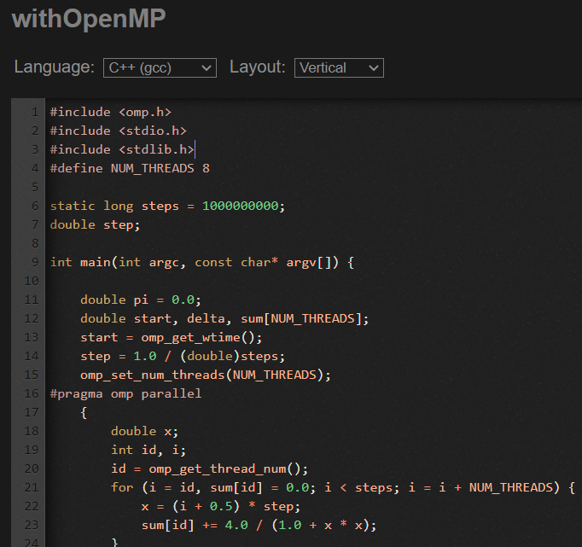
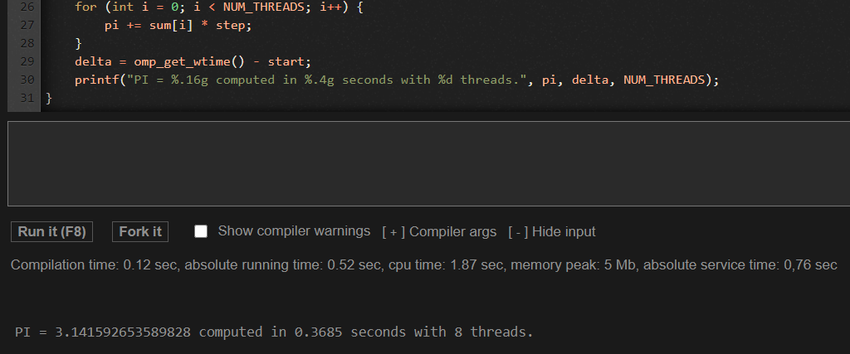
Parallel programming in Std. Algorithm Sector
4.PI value calculation with OpenMP Output

Slide 20
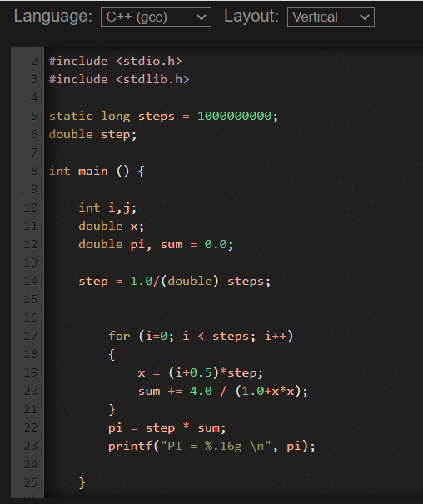
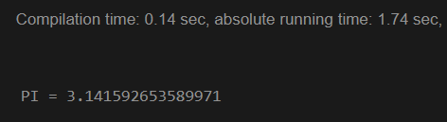
Parallel programming in Std. Algorithm Sector
4.PI value calculation without OpenMP Output
The Time taken for execution is 1.74 sec which is greater than that of 0.368 sec executed with openMP…

Slide 21
Parallel programming in Std. Algorithm Sector
4.Conclusion on Pi number calculation algo using OpenMP
omp_set_num_threads is OpenMP component that is applied to set the thread count that we require in our program.
Each thread is given a role to execute a specific set of instruction along with separate threads running parallely that keep track of each loop execution …thus if iterator work is done by thread it proves beneficial
The omp_get_time() is used to get time at any respective moment within the code and then the threads that are executing the loop,its working time can be calculated
The time achieved in parallel is very high in comparison with the serial code..because of distribution of each thread to their own loop and threads that keep track of proper execution of other threads.

Slide 22
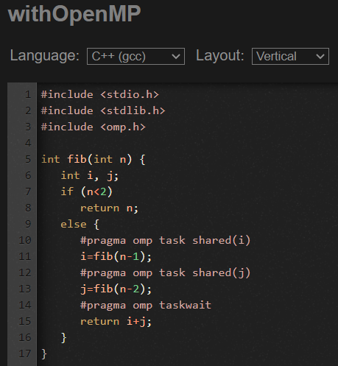
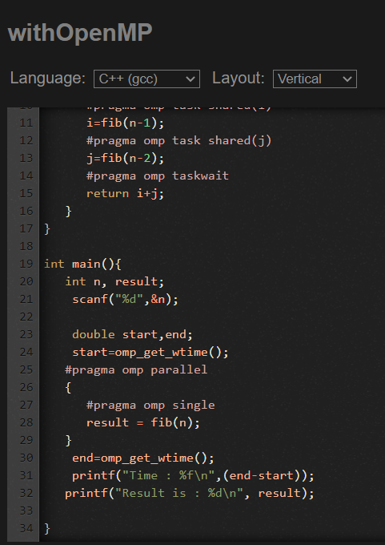
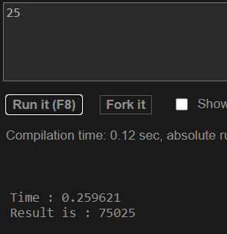
Parallel programming in Std. Algorithm Sector
5.Fibonacci series with OpenMP Output

Slide 23
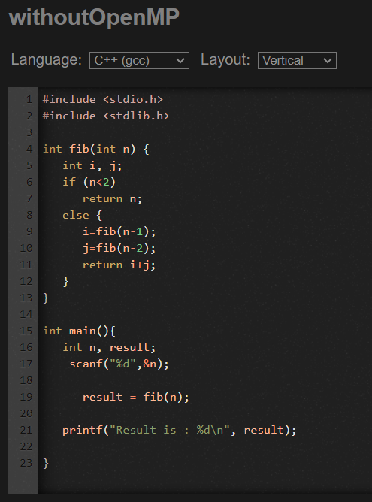
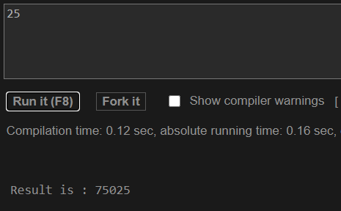
Parallel programming in Std. Algorithm Sector
5.Fibonacci series without OpenMP Output
The Time taken for execution is 0.16 sec which is smaller than that of 0.25 sec executed with openMP…thus doen’t gives desired output in case of recursive codes

Slide 24
Parallel programming in Std. Algorithm Sector
5.Conclusion on fibonacci number algo using OpenMP
#pragma omp parallel is OpenMP component that is applied When a parallel region is encountered, a logical team of threads is formed. Each thread in the team executes all statements within a parallel region except for work-sharing constructs.
Use the task pragma when you want to identify a block of code to be executed in parallel with the code outside the task region. The task pragma can be useful for parallelizing irregular algorithms such as pointer chasing or recursive algorithms.
#pragma omp single is OpenMP single thread component that is applied to fetch the result of a recursive code solution and keeps waiting until the result is fetched
The time achieved in parallel is unpredictable because in recursive code there is no surety of after how much iteration the function produces result…thus can be effective or destructive.

Slide 25
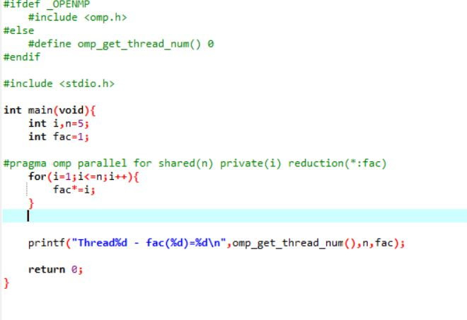
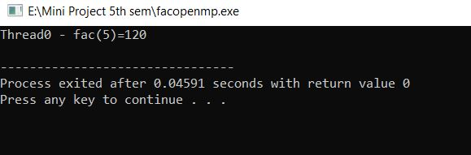
Parallel programming in Std. Algorithm Sector
Factorial of number using OpenMp

Slide 26
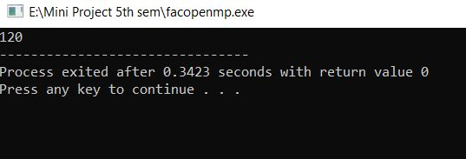
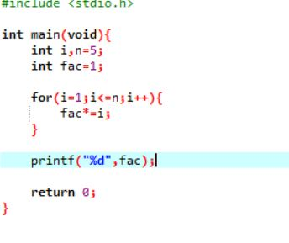
Parallel programming in Std. Algorithm Sector
Factorial of a number without OpenMp
The Time taken for execution is 0.3423 sec which is greater than that of 0.0459 sec executed with openMp.

Slide 27
Parallel programming in Std. Algorithm Sector
6.Conclusion on factorial number algo using OpenMP
#pragma omp parallel is OpenMP component that is applied When a parallel region is encountered, a logical team of threads is formed. Each thread in the team executes all statements within a parallel region except for work-sharing constructs..
omp get thread is OpenMP single thread component get the thread rank in a parallel region

Slide 28
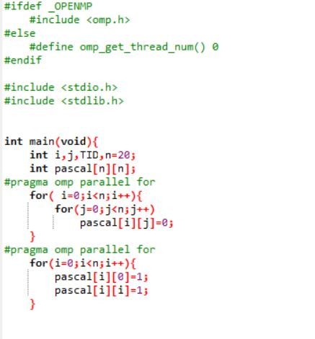
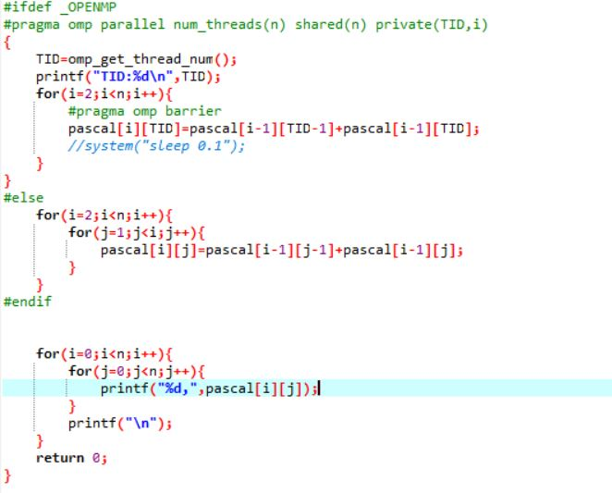
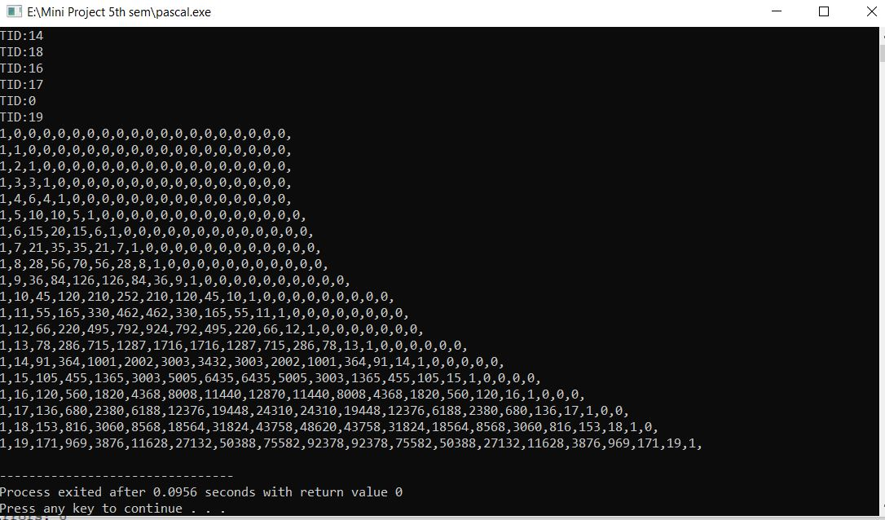
Parallel programming in Std. Algorithm Sector
Pascal triangle using OpenMp

Slide 29
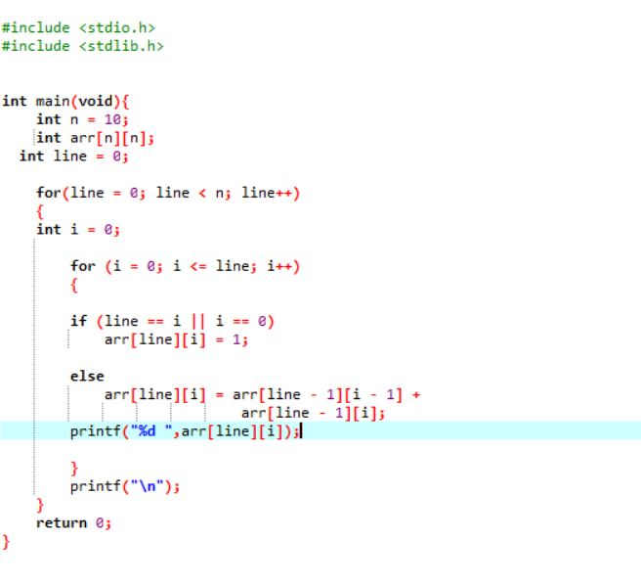
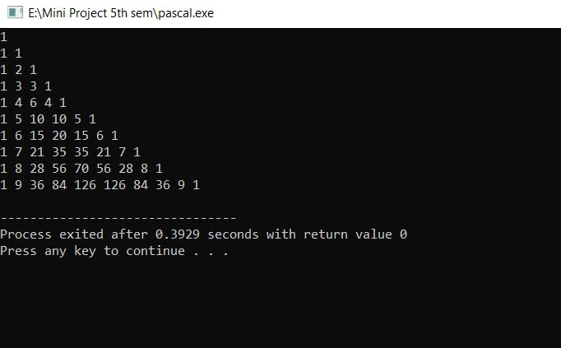
Parallel programming in Std. Algorithm Sector
Pascal triangle program without OpenMp
The Time taken for execution is 0.3929 sec which is greater than that of 0.0956 sec executed with openMp.

Slide 30
Parallel programming in Std. Algorithm Sector
7.Conclusion on pascal triangle algo using OpenMP
#pragma omp parallel is OpenMP component that is applied When a parallel region is encountered, a logical team of threads is formed. Each thread in the team executes all statements within a parallel region except for work-sharing constructs..
omp get thread is OpenMP single thread component get the thread rank in a parallel region
#pragma omp barrier is directive identifies a synchronization point at which threads in a parallel region will wait until all other threads in that section reach the same point. Statement execution past the omp barrier point then continues in parallel.

Slide 31
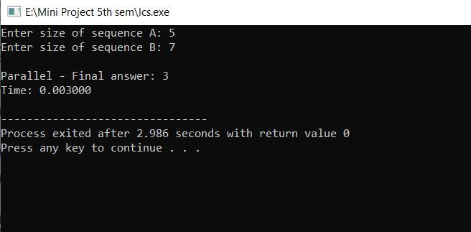
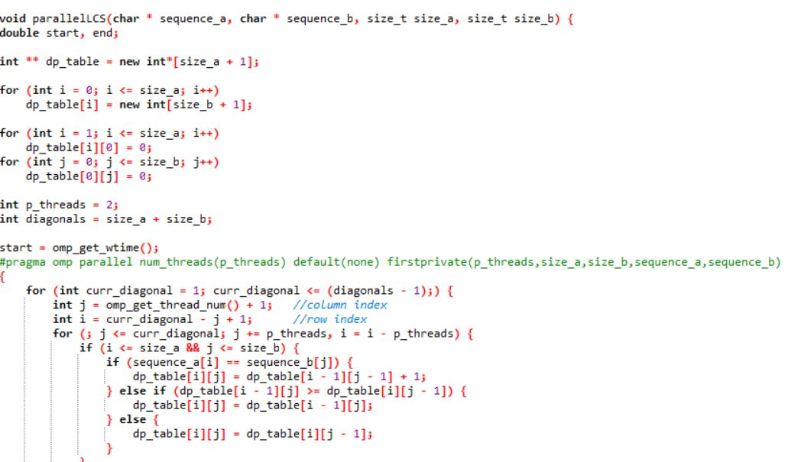
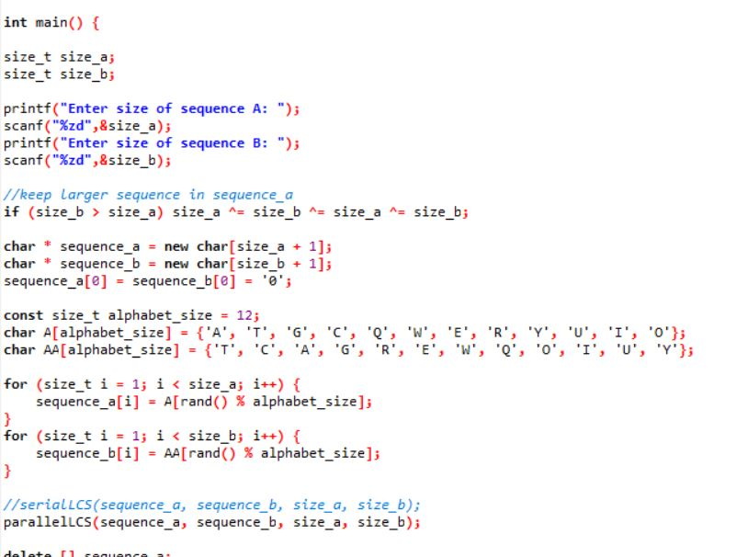
Parallel programming in Std. Algorithm Sector
LCS DP with OpenMp

Slide 32
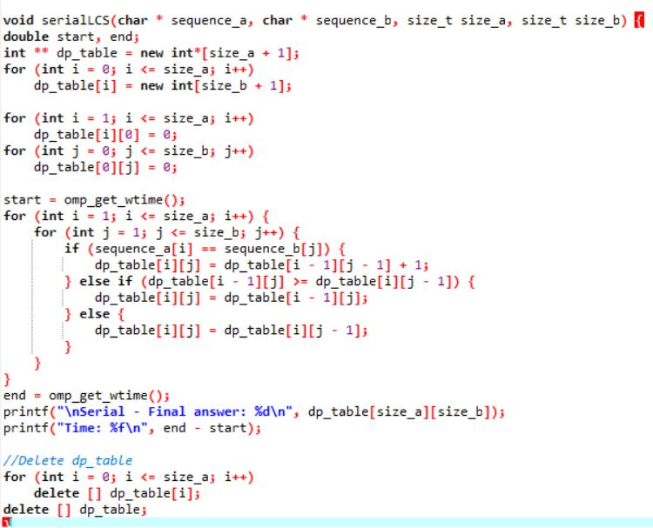
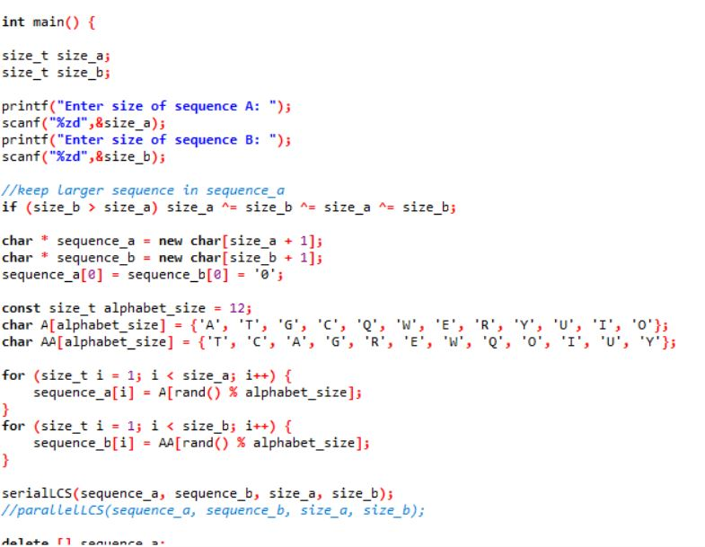
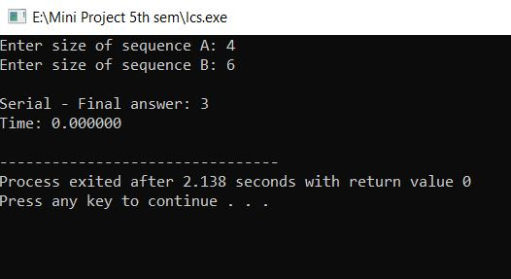
Parallel programming in Std. Algorithm Sector
LCS DP without DP
The Time taken for execution is 0.00 sec which is greater than that of 0.003 sec executed with openMp because in dp problems recursive calls are more

Slide 33
Parallel programming in Std. Algorithm Sector
8.Conclusion on LCS DP algo using OpenMP
#pragma omp parallel is OpenMP component that is applied When a parallel region is encountered, a logical team of threads is formed. Each thread in the team executes all statements within a parallel region except for work-sharing constructs..
#pragma omp barrier is directive identifies a synchronization point at which threads in a parallel region will wait until all other threads in that section reach the same point. Statement execution past the omp barrier point then continues in parallel.

Slide 34
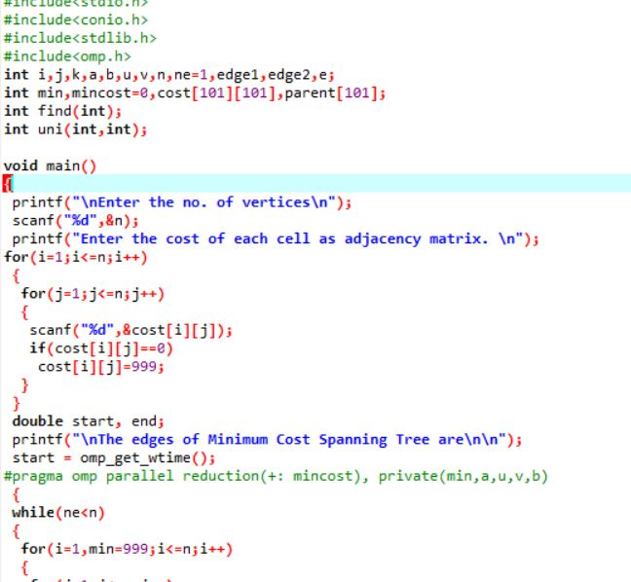
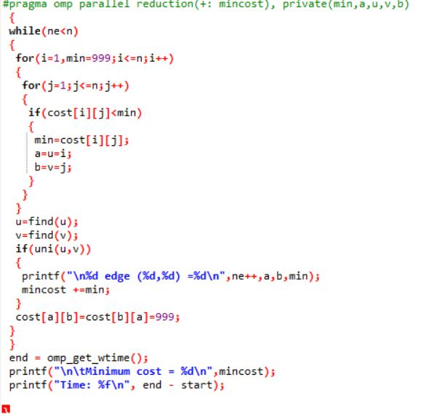
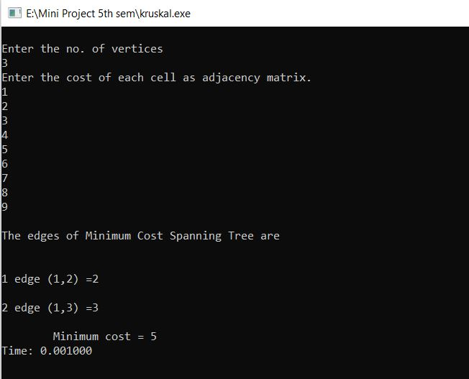
Parallel programming in Std. Algorithm Sector
Kruskals algorithm using openmp

Slide 35
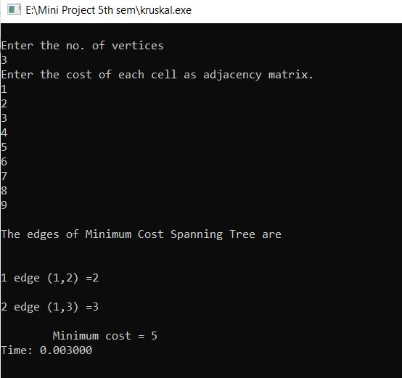
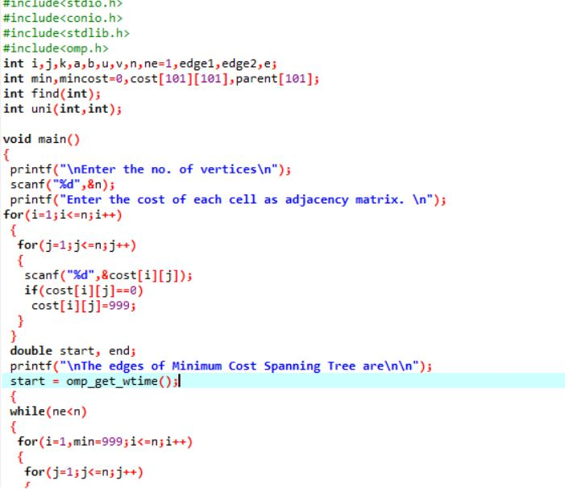
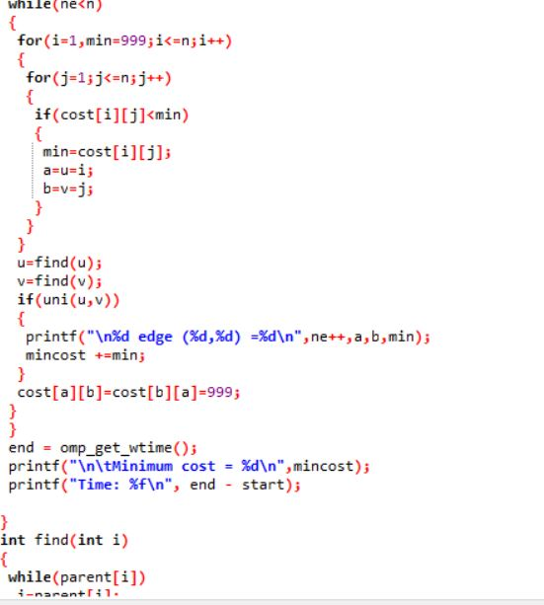
Parallel programming in Std. Algorithm Sector
Kruskal Algo without OpenMp
The Time taken for execution is 0.003 sec which is greater than that of 0.001 sec executed without openMp

Slide 36
Parallel programming in Std. Algorithm Sector
9.Conclusion on Kruskal algo using OpenMP
#pragma omp parallel is OpenMP component that is applied When a parallel region is encountered, a logical team of threads is formed. Each thread in the team executes all statements within a parallel region except for work-sharing constructs..

Slide 37
Literature
Study of OpenMP to achieve best use of hardware with parallel programming in CPP-
a)OpenMp channel on youtube provides a easy way of learning parallel programming through openmp and how to design and write code
b)A course on openmp is available on nptel .It is also a great learning platform for learning openmp in depth
c)”Learn more-multithread with openmp” is a course available on coursera to master in openmp

Slide 38
Literature
Implementing the codes for widely used algorithms in regular way of serial programming and then same algorithms in parallel programming-
a)The understanding and working of algorithm can be achieved through karumanchi book on “data structure and algorithm”
b)GFG can be used to obtain serialized standard algorithms with most efficient time complexity
c)”Dev c++” guide can help us to optimize setting so that we are able to execute our parallel codes temporarily.

Slide 39
Literature
A study of image processing algorithms. Writing IP algorithms into CPP and converting serial code to efficient parallel code. Compare time taken in regular serial operations and parallel operations-
a)Image processing algo can be learned through Gonzalez book on “digital image processing”
b)A large number of image would be required for testing in .png format that would be available on google or png libraries
c)Learn to Apply OpenMP parallel computing technique using matrix and result analysis using c++ by learning through youtube.

Slide 40
Literature
Design an web app based user interface to display achieved efficiency in time through parallel programming. We will use React.js library to create the UI and online gcc compiler to run our codes -
a) There are tutorials on codevolution youtube channel for learning
React.js
b) Documentation is also present on official website of React.js
c) Other sources are- w3schools, tutorialspoint , javatpoint
d) Udemy course:- The Complete Web Developer in 2020 Zero to Mastery
d) Compiler is present at-> https://rextester.com/l/cpp_online_compiler_gcc

Slide 41
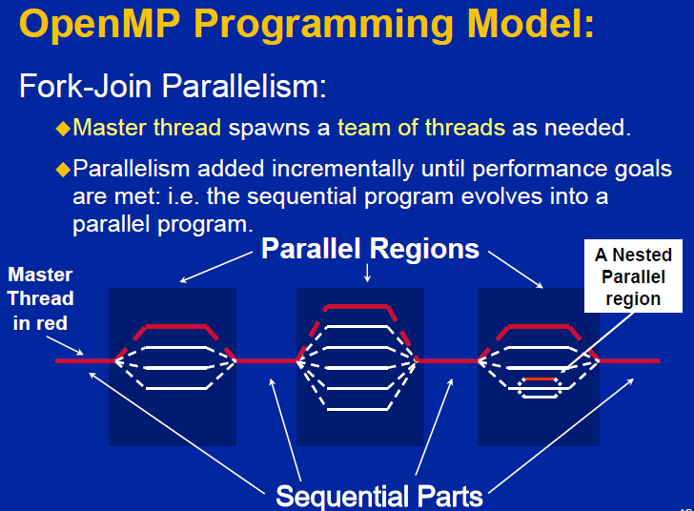
Design Methodology

Slide 42
Methodology Continued… Algorithms Section
Select 10-15 Algorithms
Implement In Serial Manner Using CPP
Use OpenMP

Slide 43
Methodology Continued… IP Section
Select IP techniques
Parallelisation could be applied or achieved in two different ways.
Coarse Grain Parallelism : Images level i.e. each core would process separate image
Fine Grain Parallelism : Operation level i.e. all the cores would altogether process a single image.

Slide 44
Methodology Continued… UI Section
React.js
Online gcc compiler

Slide 45
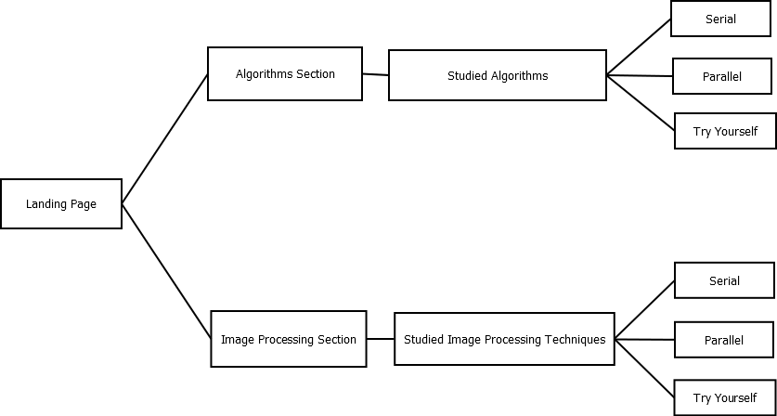
Acitivity Diagram

Slide 46



Technology Stack
C/C++
OpenMP
PNG Specification
PNG Library
React.js
Online-gcc-compiler

Slide 47
Target audience
Enthusiasts in field of Image Processing.
Enthusiasts in field of machine learning.

Slide 48
Limitations
Performance speedup depends on system configuration .
Performance may vary from system to system.
System should be idle while performing parallel implementations otherwise it may not give it’s best.

Slide 49
References
Introduction to OpenMp by Tim Matson
PNG specification
Nptel course on OpenMp
Coursera course to master OpenMp
GFG for codes of standard algorithms
Gonzalez book to learn “Digital Image Processing”
Codevolution Youtube Channel to learn React.js

Slide 50
QNA
Q : What is parallel programming ?
A : Parallel computing is the simultaneous use of multiple compute resources to solve a computational problem.
Q : Which standard algorithms have you used in your project ?
A : Bubble sort , Selection sort, Matrix multiplication, Fibonacci sequence, LCS, DFS, etc.
Q : Which image processing techniques have you used in your project ?
A : Image blurring, edge detection, contrast streching, image negation, conversion from rgb to gray etc.
Q : How will you compare the time difference in your parallel and serial programs?
A : We’ll execute each program independently and will calculate the total time of their execution.
Then we’ll run all the tasks parallely and then calculate the time difference.

Slide 51
QNA
Q : Why are you using React.js library ?
A : It is good for frontend and is used very widely in industry.
Q : Which online compiler are you using ?
A : GCC compiler
Q : What is use of your project in the market ?
A : In the market, this platform can establish its reputation as an efficient, reliable and faster environment for conducting various image processing applications.
As many programs are carried out at same time , it will also save money.

Slide 52
Team
Guided By
Asst. Prof. P. Mundada
Mr. ADITYA GADADHANI 2018BTECS00034
Mr. SHREYAS MANDADE 2018BTECS00035
Mr. ABHISHEK MORE 2018BTECS00037

Slide 53
Thank You

